Slide 1
MIS PRESENTATION
ANIRUDH EDPUGANTI
ONTEDDU CHAITANYA REDDY
PILLALAMARRI AKSHAYA
PINGALI SATHVIKA

Slide 2
Data generation for non convex clusters
01
K Means Clustering
02
TABLE OF CONTENTS
04
Spectral Clustering
03
05
Comparison of performance
Inference
06
Results

Slide 3
01
DATA SET GENERATION

Slide 4
What are Convex & Non Convex Clusters?
A subset of a Euclidean space, or more generally an affine space over the reals, is convex if, given any two points in the subset, the subset contains the whole line segment that joins them.
A set that is not convex is called a non-convex set. A polygon that is not a convex polygon is sometimes called a concave polygon, and some sources more generally use the term concave set to mean a non-convex set, but most authorities prohibit this usage.

Slide 5
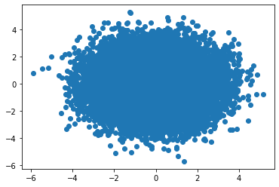
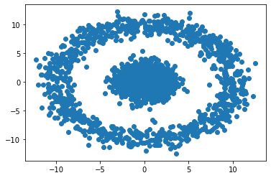
Intuition behind Convexity
Convex Set
Non-Convex Set

Slide 6
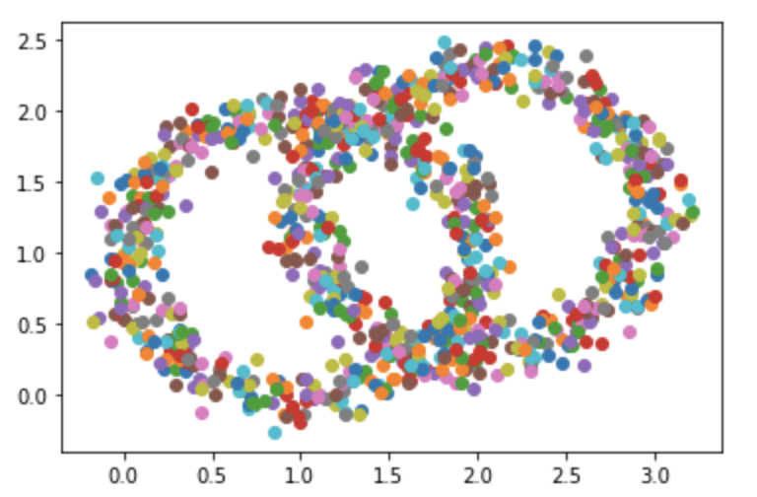
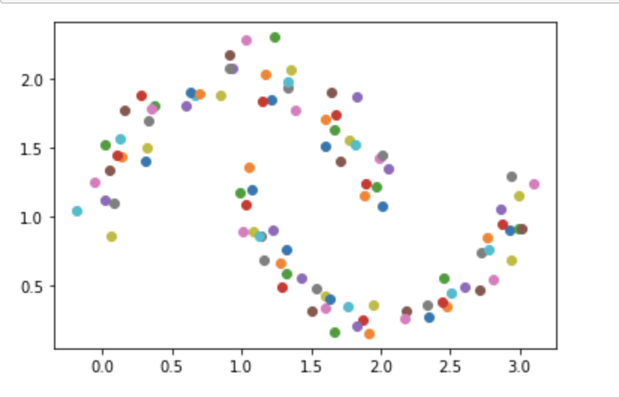
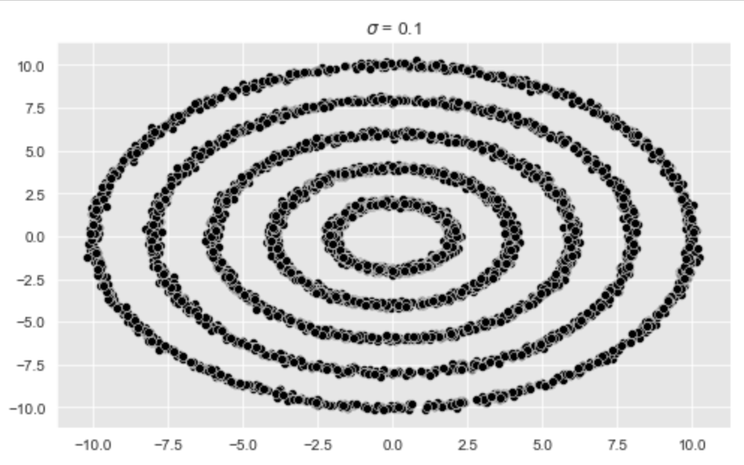
Non Convex clusters generated

Slide 7
02
K means Clustering

Slide 8
K means Clustering
This algorithm groups the unlabeled dataset into different clusters. K will define the number of clusters that need to be created in the process.
It is an iterative algorithm that divides the unlabeled dataset into k different clusters such that each dataset belongs to only one group that has similar properties

Slide 9
Main task of K means
K means
Assigns each data point to its closest k-centre. Those data points which are near to the particular k-centre, create a cluster.
Determines the best value for K center points or centroids by an iterative process.

Slide 10
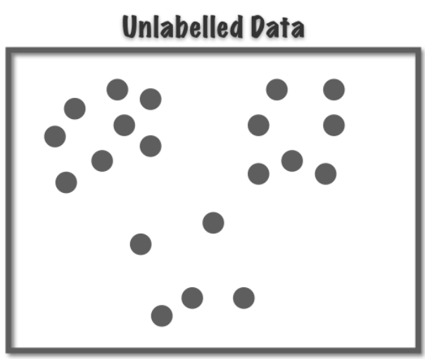
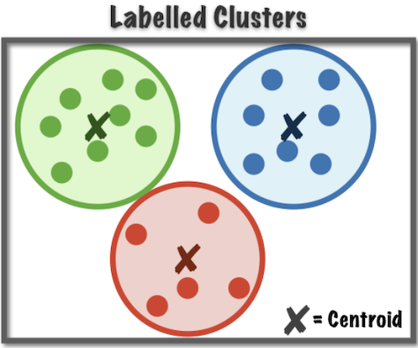
Before K means
After K means

Slide 11
Working of K means
Select the number K to decide the number of clusters.
Select random K points or centroids.
Assign each data point to their closest centroid, which will form the predefined K clusters.
Calculate the variance and place a new centroid of each cluster.
Repeat the third steps, which means reassign each datapoint to the new closest centroid of each cluster.
If any reassignment occurs, then go to step-4 else go to FINISH. The model is ready.

Slide 12
How to choose the value of "K number of clusters" in K-means Clustering?
Elbow Method
The Elbow method is one of the most popular ways to find the optimal number of clusters. This method uses the concept of WCSS value. WCSS stands for Within Cluster Sum of Squares, which defines the total variations within a cluster.
$$\text{WCSS}\text{= ∑}\text{Pi} \text{in} \text{Cluster}\text{1 }\text{distance}\text{(}\text{Pi} \text{C}\text{1}\text{)}\text{2}\text{ +∑}\text{Pi} \text{in} \text{Cluster}\text{2}\text{distance}\text{(}\text{Pi} \text{C}\text{2}\text{)}\text{2}\text{+∑}\text{Pi} \text{in} \text{CLuster}\text{3 }\text{distance}\text{(}\text{Pi} \text{C}\text{3}\text{)}\text{2}$$

Slide 13
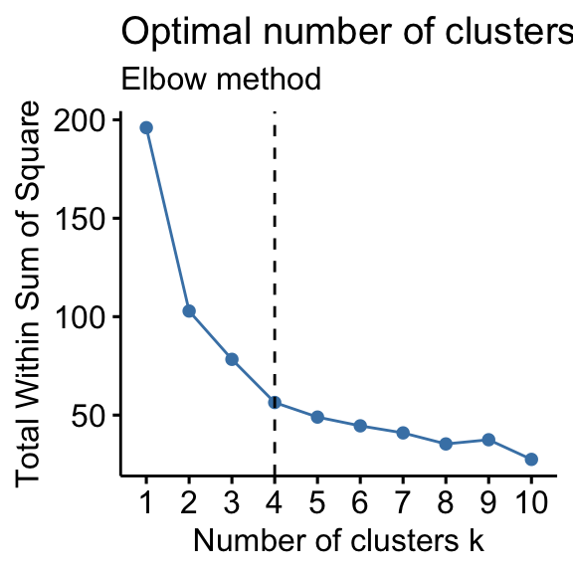
To find the optimal value of clusters, the elbow method follows the below steps:
It executes the K-means clustering on a given dataset for different K values (ranges from 1-10).
For each value of K, calculates the WCSS value.
Plots a curve between calculated WCSS values and the number of clusters K.
The sharp point of bend or a point of the plot looks like an arm, then that point is considered as the best value of K.

Slide 14
SIMULATION

Slide 15
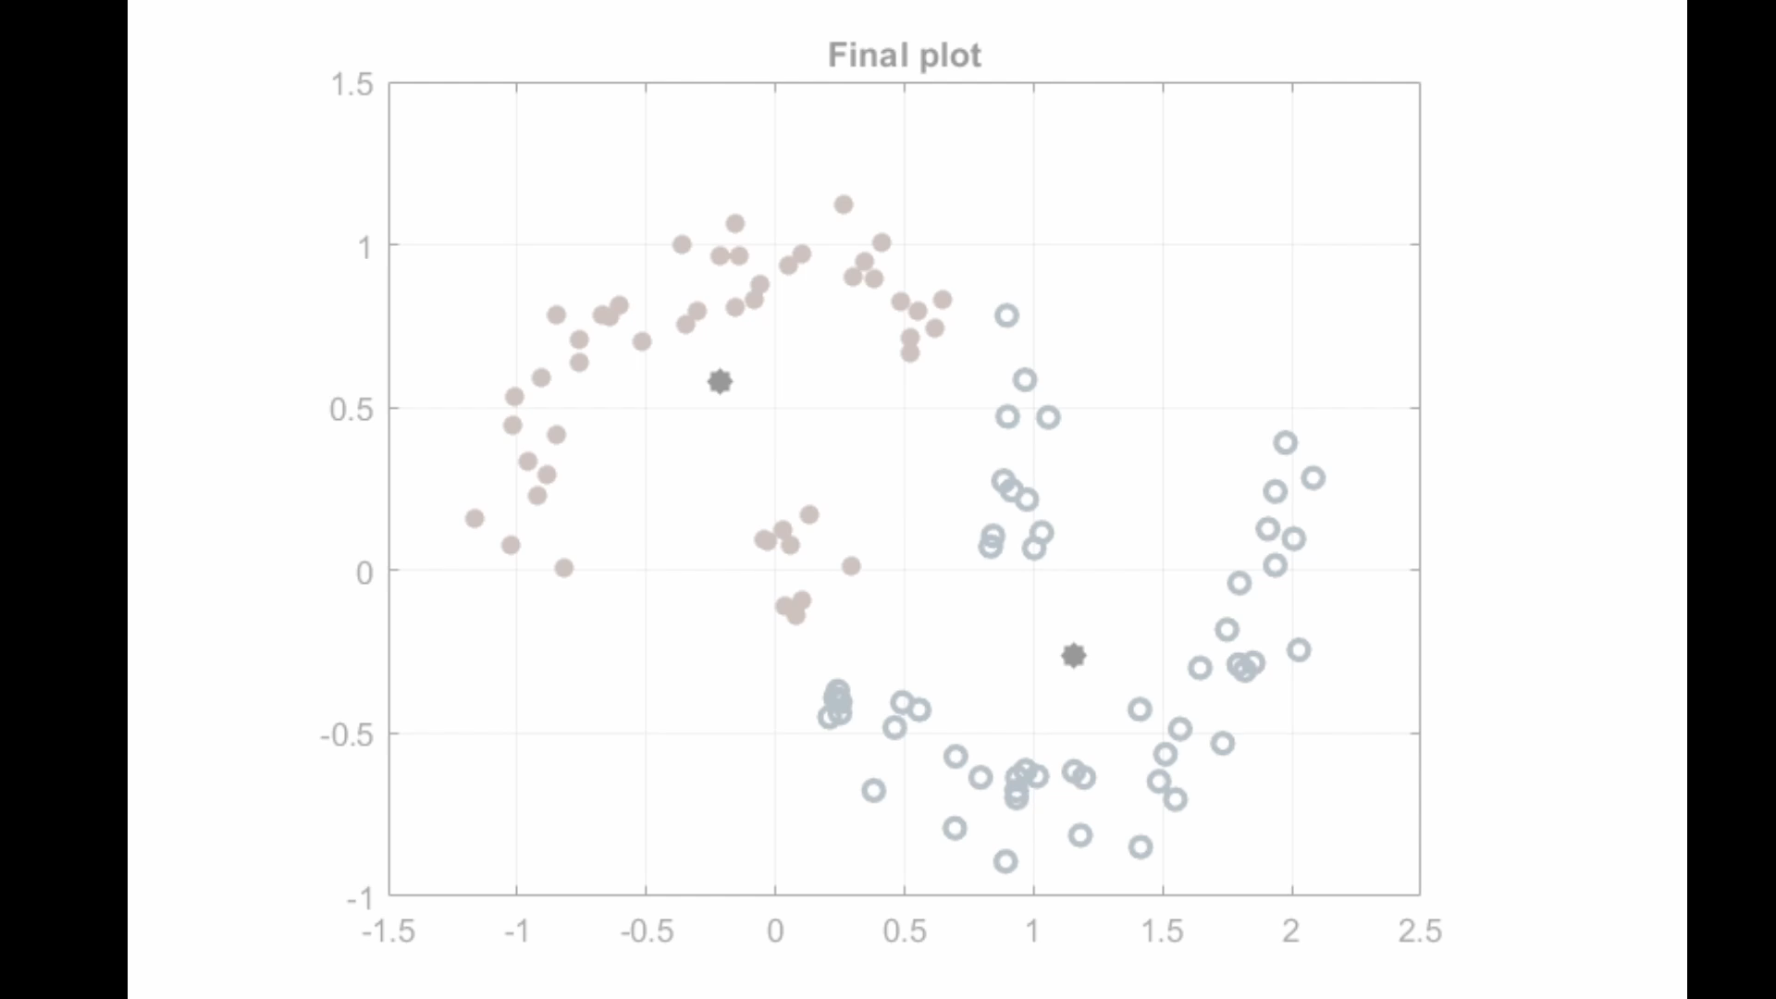

Slide 16
03
SPECTRAL CLUSTERING

Slide 17
Spectral Clustering
Spectral clustering is flexible and allows us to cluster non-graphical data as well. It makes no assumptions about the form of the clusters. Clustering techniques, like K-Means, assume that the points assigned to a cluster are spherical about the cluster centre
Spectral Clustering is a growing clustering algorithm. It treats each data point as a graph-node and thus transforms the clustering problem into a graph-partitioning problem.
Spectral Clustering helps create more accurate clusters. It can correctly cluster observations that actually belong to the same cluster, but are farther off than observations in other clusters, due to dimension reduction.

Slide 18
How does Spectral Clustering work?
The three major steps involved in spectral clustering are: constructing a similarity graph, projecting data onto a lower-dimensional space, and clustering the data.
Given a set of points S in a higher-dimensional space, it can be elaborated as follows:
1. Form a distance matrix
2.Transform the distance matrix into an affinity matrix A

Slide 19
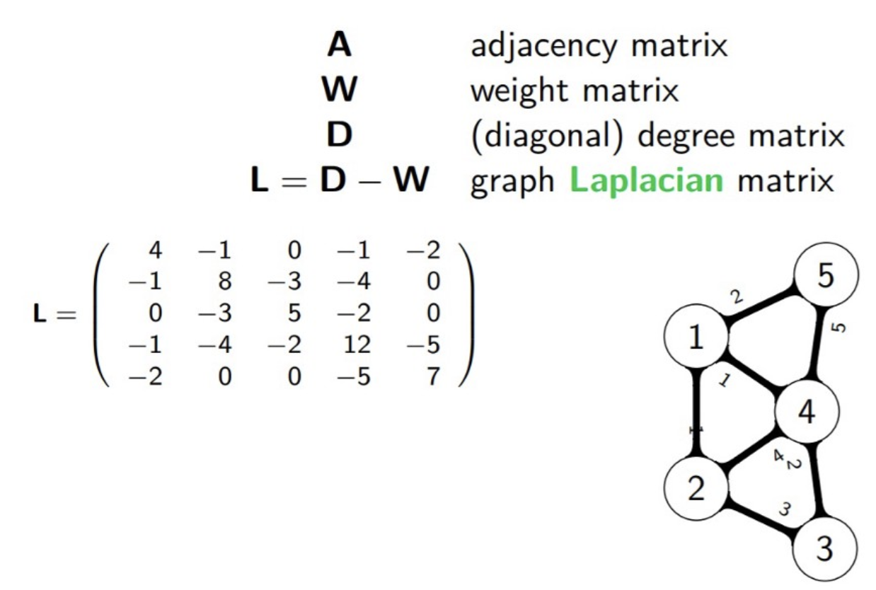
3. Compute the degree matrix D and the Laplacian matrix L = D – A.
4. Find the eigenvalues and eigenvectors of L.
5.With the eigenvectors of k largest eigenvalues computed from the previous step form a matrix.
6. Normalize the vectors.
7. Cluster the data points in k-dimensional space.

Slide 20
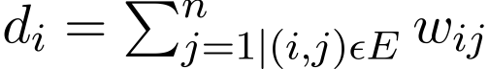
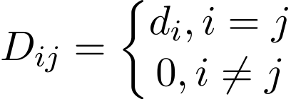
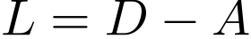
A typical implementation consists of three fundamental steps:-
Building the Similarity Graph: This step builds the Similarity Graph in the form of an adjacency matrix which is represented by A. The adjacency matrix can be built in two ways
1.Epsilon-neighbourhood Graph
2.K-Nearest Neighbours
Projecting the data onto a lower Dimensional Space: This step is done to account for the possibility that members of the same cluster may be far away in the given dimensional space.
The degree matrix is defined as follows:-
Thus the Graph Laplacian Matrix is defined as:-

Slide 21
This Matrix is then normalized for mathematical efficiency. To reduce the dimensions, first, the eigenvalues and the respective eigenvectors are calculated.
If the number of clusters is k then the first k eigenvalues and their eigen-vectors are taken and stacked into a matrix such that the eigen-vectors are the columns
Clustering the Data: This process mainly involves clustering the reduced data by using any traditional clustering technique – typically K-Means Clustering.
First, each node is assigned a row of the normalized of the Graph Laplacian Matrix. Then this data is clustered using any traditional technique. To transform the clustering result, the node identifier is retained..

Slide 22
04
Results

Slide 23
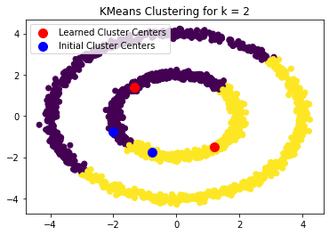
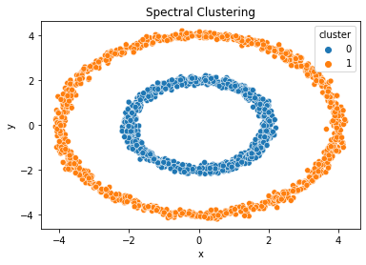
K means Vs Spectral Clustering

Slide 24
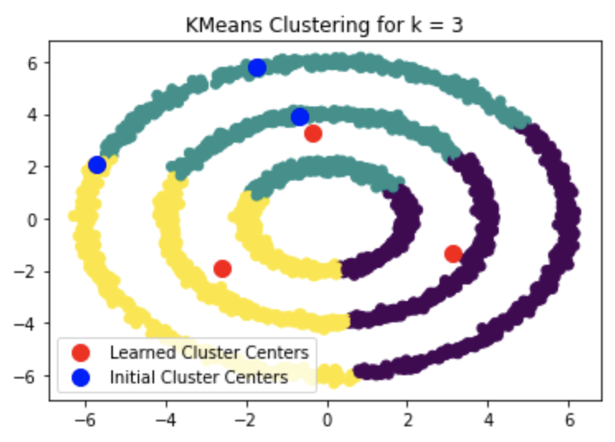
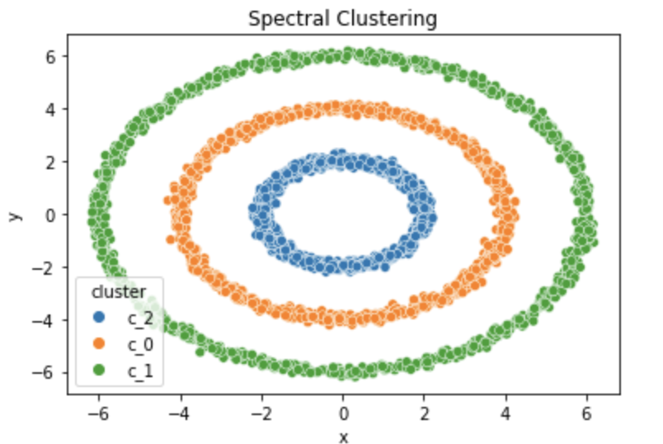
K means Vs Spectral Clustering

Slide 25
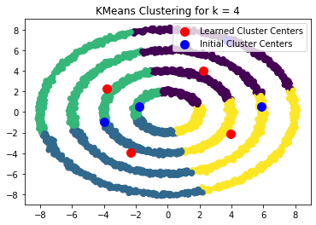
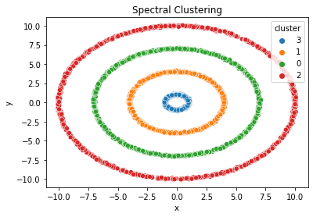
K means Vs Spectral Clustering

Slide 26
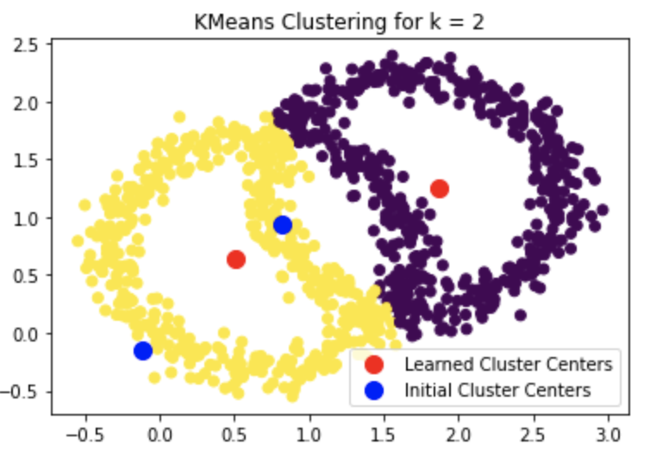

Slide 27
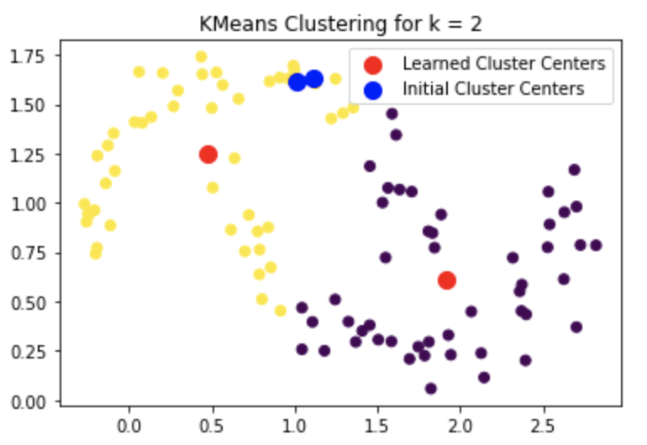
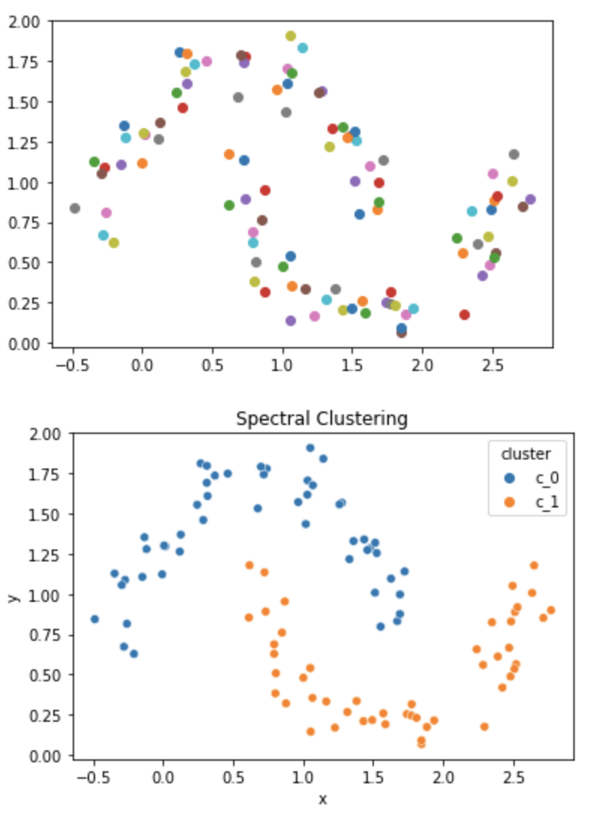

Slide 28
05
Comparison of Performance

Slide 29
Spectral Clustering
K means
Even when the true number of clusters K is known to the algorithm, K-means is failing to cluster the above data successfully. This is because K-means is a good data clustering algorithm for finding globular groups where all cluster members are close to each other (in the Euclidean sense).
Graph-clustering approaches such as spectral clustering, on the other hand, do not cluster data points directly in their native data space but instead build a similarity matrix with the (i,j)th row representing some similarity distance between the ith and jth data points in your dataset.

Slide 30
06
Inference

Slide 31
In some ways, spectral clustering is more general (and powerful) than K-means since spectral clustering is applicable whenever K-means is not (just use a simple Euclidean distance as the similarity measure).
However, the opposite is not true. When choosing one of these strategies over the other, there are some practical concerns to keep in mind. The input data matrix is factorized with K-means, whereas the Laplacian matrix is factorized with spectral clustering (a matrix derived from the similarity matrix).

Slide 32
THANK YOU MAM

